Slide 1

DEPOSIT INSURANCE AROUND THE GLOBE: WHERE DOES IT WORK?
By A.D Kunt & E.J Kane
Presentation by Mickael Trintignac

Slide 2
Abstract of the Paper
Studies the extent of cross-country differences in deposit-insurance
Reviews empirical evidence on how design features affect private market discipline, banking stability, financial development and effectiveness of crisis resolution
Challenges the view of encouraging countries to implement deposit insurance without fixing their institutional environment first

Slide 3
What does Deposit Insurance mean?
Measure to protect bank depositors if bank is unable to pay its debts
Most of the time, Deposit Insurance are government established. Can also be financed privately, or a mix of both
Coverage rules vary across countries.
Goal of deposit insurance is to both make systematic breakdowns less likely AND to limit disruption and fiscal costs when they occur.

Slide 4
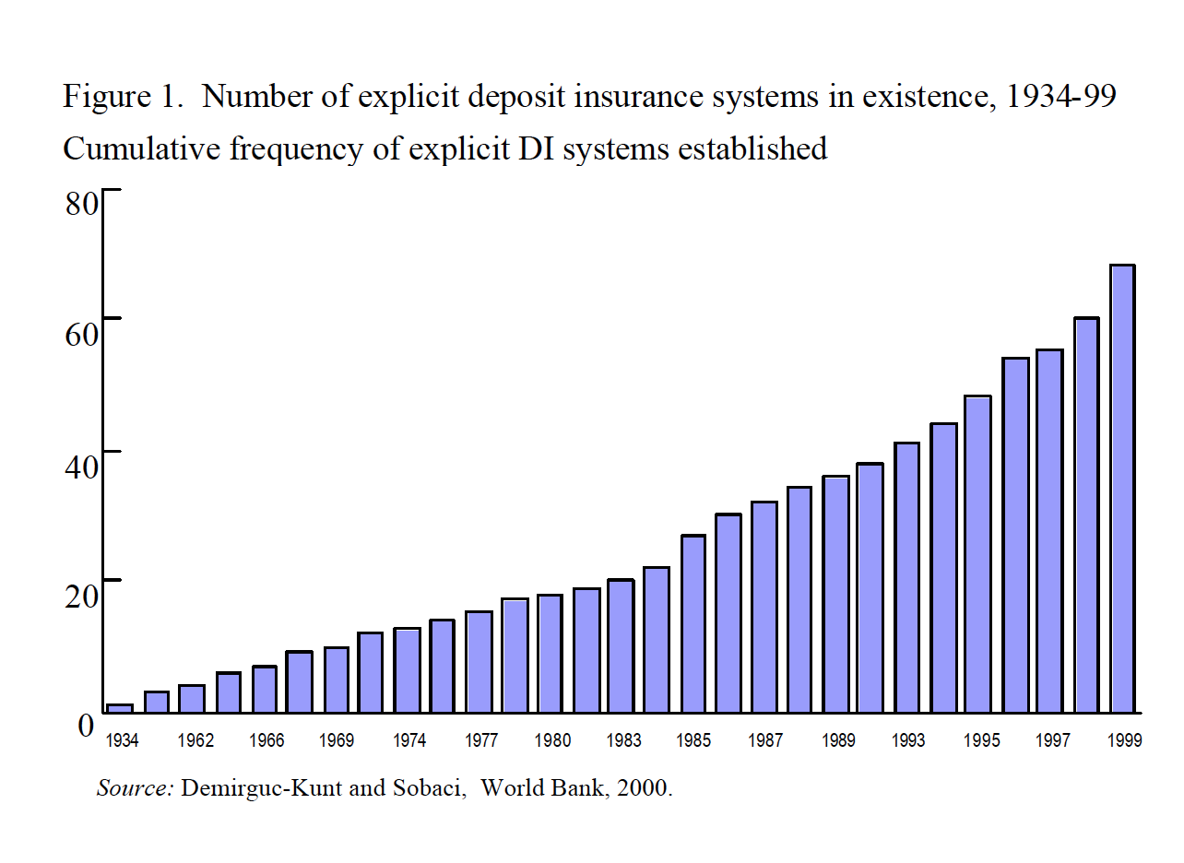
A Growing Interest for Deposit Insurance

Slide 5
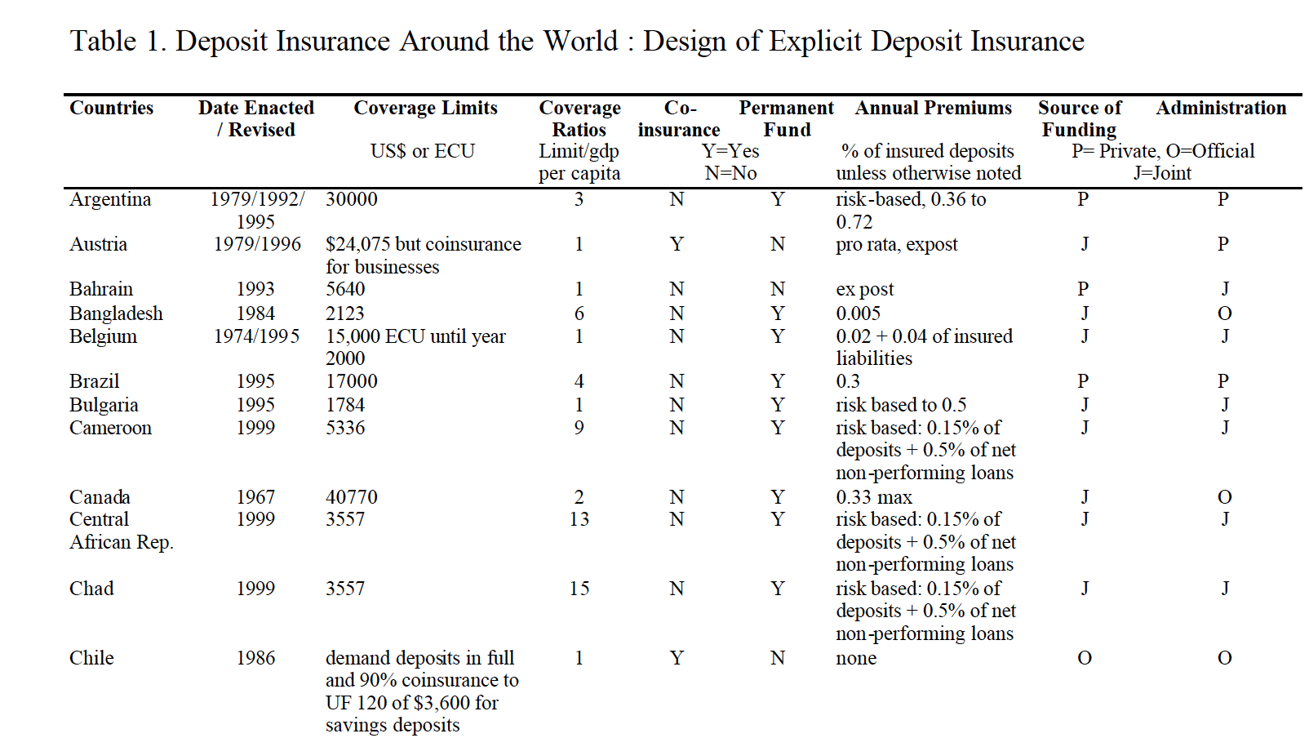
Deposit Insurance Around the World

Slide 6
Main Limitation: Moral Hazard
Danger that insurance will induce a deliberate increase in improper risk-taking
Kane (2000) emphasizes that controlling bank risk-taking requires transparency, deterrency, and requires accountability to taxpayers for successes and failures.

Slide 7
Other Dangers
Liquidity must be offered only to potentially solvent institutions in order to end a panic efficiently
Government forms of bailout support rewards bad bankers and penalizes good ones.
Such a policy changes market discipline and risk-taking incentives and imposes unanticipated obligations on the national treasury.
“it promises new and deeper crises in years to come”

Slide 8
Kunt & Kane ask 4 Questions
How does deposit insurance affect bank stability?
How does deposit insurance affect market discipline?
How does deposit insurance impact financial development?
What role does deposit insurance play in managing crises?

Slide 9
1- How does deposit insurance affect bank stability?
Because safety nets are so effective in arresting runs, safety nets generate moral hazard.
Bankers can exploit weaknesses
Regulators have no incentive to enforce a prudential set of laws
Their regression shows deposit insurance is problematic when coverage is broad, and when it is administered by government rather than private sector.

Slide 10
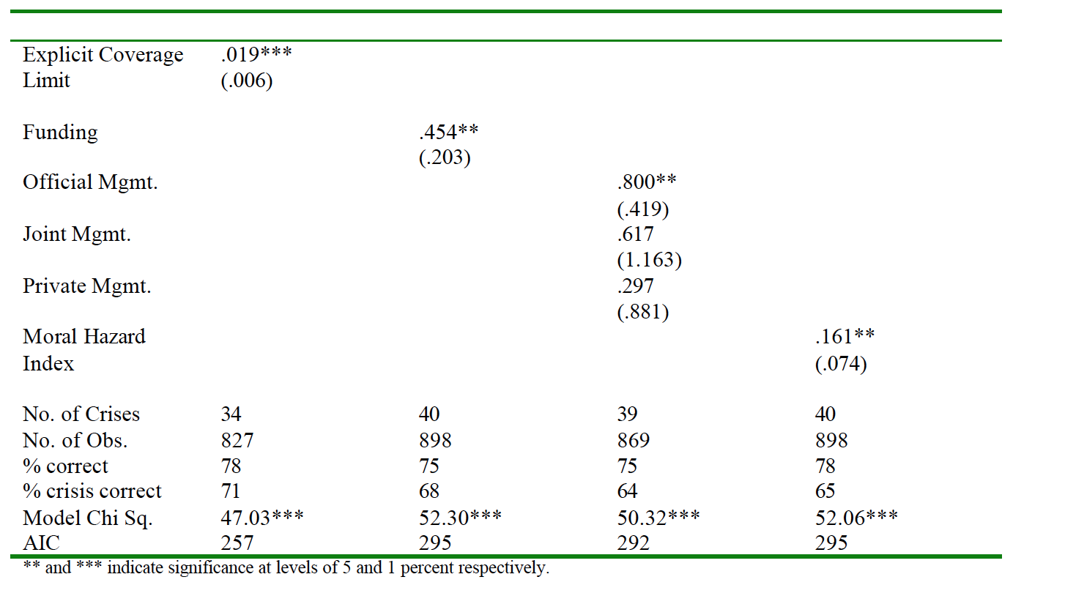
Deposit Insurance and Banking Crisis Regression

Slide 11
2- How does Deposit Insurance affect market discipline?
Shift of responsibility from the depositors to the regulators
Badly designed deposit insurance can decrease market discipline
Countries with poor contract laws are most likely to suffer adverse consequences from deposit insurance.

Slide 12
3- How does Deposit Insurance Impact Financial Development?
A reason to use deposit insurance is to increase the flow of bank credit
It boosts the confidence the general public has in the banking system.
In institutionally weak countries, deposit insurance appears to slow down financial development.
Need to start with an audit of the degree of transparency, deterrency, and accountability present in their institutional structure.

Slide 13
4- What Role does Deposit Insurance play in Managing Crisis?
Supporters of using safety-nets to halt a systemic crisis argue that sweeping guarantees can be helpful, even essential, in halting depositors’ flight to quality.
They undermine market discipline and may prove greatly destabilizing over longer periods
Study by Honohan and Klingebiel (2000).
Deposit Insurance is unlikely to help accelerate the economy recovery from banking crisis or help to experience a smaller output loss.

Slide 14
Critiques
Easy to analyze positive effect of deposit insurance
A lot installed right after crisis, but positive after-crisis does not necessarily mean causality effect from Deposit Insurance.
They take a different route
Could have use more data.
Deposit Insurance Database publication by Kunt in 2014.

Slide 15
Conclusion
Policymakers should view the positive correlation between explicit deposit insurance and banking crises as a wakeup call
Regulations and institutions have a key role to play
Could be a challenge in developing countries
Banks are tempted to exploit monitoring weakness
Countries with poorly designed deposit insurance or weak institutions should not start by implementing these safety-nets

Slide 16
How Deposit Insurance should be designed?
Some features can minimize the threat to financial stability from decrease in market discipline that banks experience
Depositors need to understand that their funds are still at risk.
This exposure to loss gives them an incentive to monitor the behavior of both banks and safety- net managers
Need to identify institutional prerequisites for adopting deposit insurance and to make a concerted effort to get system's design right

